Slide 1
Shell Bootcamp 2024 Reflections for the training
16/09/2024 to 19/09/2024
Sakshi Neeraj
Date : 19-Sep-2024

Slide 2
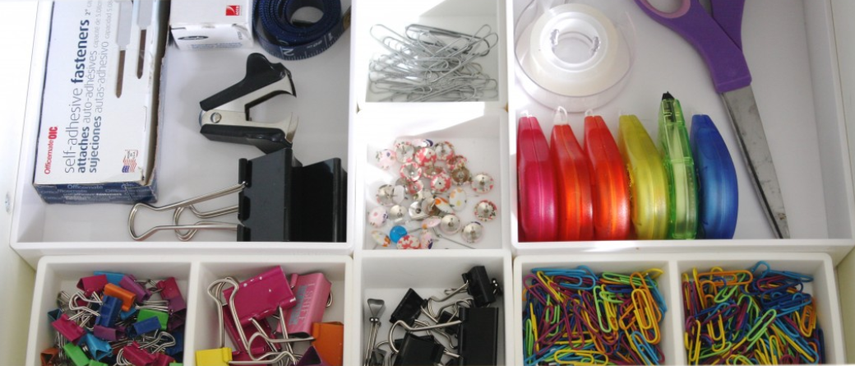
About Me
B. Tech Computer Science Engineer
Specialized in Data Science and Analytics
Permanent resident at Delhi
Organized
Good at time management
Hobby is cooking
Organized
Organized and managed

Slide 3

My learnings from this week!

Slide 4
Learning 1 | My takeaways
In this week we learnt about Docker as a containerization tool and Kubernetes for container orchestration.
We learnt about different monitoring tools like Prometheus and Grafana
We also wrote Infrastructure as a Code in Chef to automate configuration of Virtual Machines

Slide 5
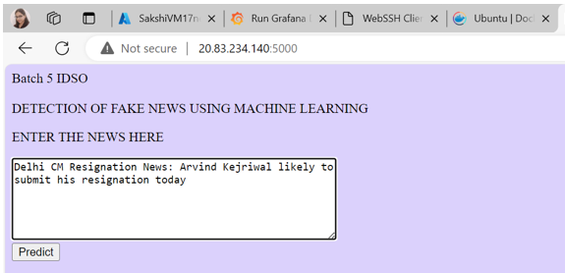
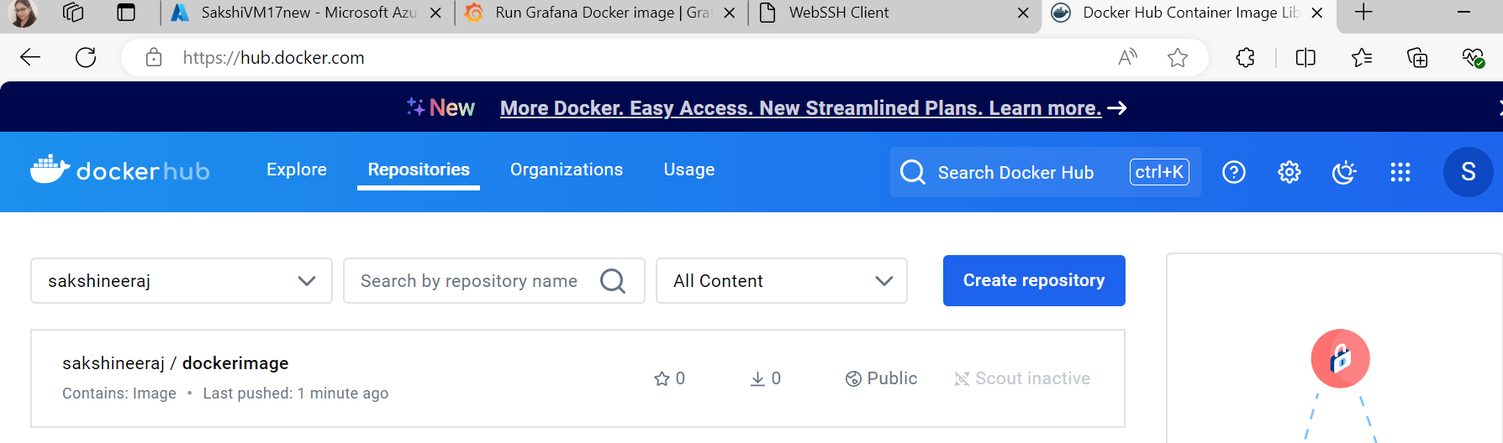
Learning 2 | My takeaways
Containerized Docker Application
Performed case study with the following objectives-
To make a Flask based Web Application
Containerize it using Docker
Configure VMs using Chef
Manage the container using Kubernetes
The Web Application should be monitored using Prometheus and Grafana

Slide 6

Relevance of learnings for my organization

Slide 7
Learnings | Relevance for Shell
Learning about containerization techniques like Docker will help an organization to deliver its applications and products in software efficient and scalable
Chef to automate configurations of infrastructure helps organizations to manage remote resources like Virtual Machines which can be eventually used for production of services and applications

Slide 8

Challenges in implementing learning

Slide 9
Challenge faced while implementing Learnings
Implementing Kubernetes and joining control plane and worker node in a cluster was difficult
Autoscaling of Kubernetes Clusters needs knowledge about Kubernetes networks in depth

Slide 10

Learning is also Fun!

Slide 11
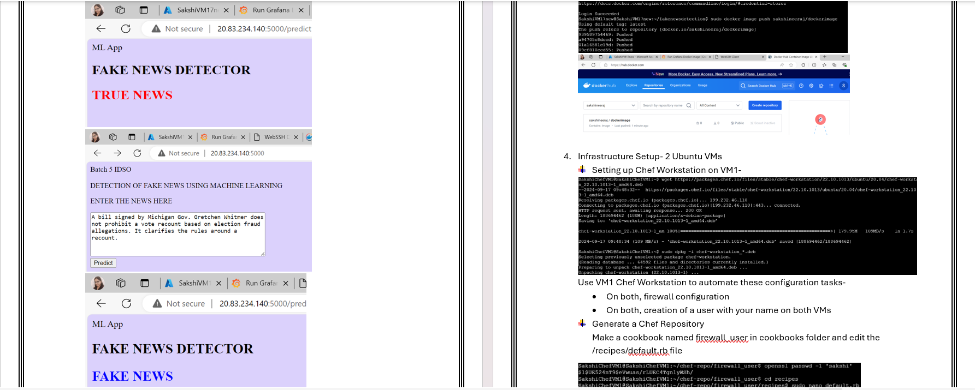
Learning is also Fun!
Case Study Presentation

Slide 12

Summary
Learnt about DevOps practices
Learnt about-
Docker
Kubernetes
Chef
Performed case study with contaninerization of Web App and also automating infrastrucutr setup of Azure VMs using Chef IAC

Slide 13
Thank You

